Slide 1
Data Access Part 2
Module 3

Slide 2
Objectives
Executing Operations
Execute method of the Organization Service
Common Request and Response classes
Using Metadata
Using Metadata Requests to Create Entities and Attributes

Slide 3
Organization Service Execute method
Execute method is underlying method of Organization Service
Create, Retrieve, RetrieveMultiple methods etc. encapsulate Execute method
Execute method receives OrganizationRequest and returns OrganizationResponse
Entity newlead=new Entity("lead");//populate
EntityReference target = newlead.ToEntityReference();
Entity systemUser = new Entity("systemuser");//populate
EntityReference assignee = systemUser.ToEntityReference();
AssignRequest request = new AssignRequest()
{
Target = target,
Assignee = assignee
};
AssignResponse response=(AssignResponse) service.Execute(request);
Notes:
The Execute method is passed an OrganizationRequest message object and returns an OrganizationResponse message. The Request and Response Message types are base classes which are derived by 200 + custom types, such as AssignRequest, CalculateRollupFieldRequest, ExportSolutionRequest, RetrieveMultipleRequest, Some of these OrganizationRequest types perform CRUD operations, others CRM System management operations. Each derived type has specific properties, to pass data to CRM and different return types.
The OrganizationService CRUD operations (Create, Update, Delete, Retrieve) are all encapsulations of the basic Execute method, and can be performed by using the Execute method and the appropriate OrganizationRequest messages (CreateRequest, RetrieveRequest, UpdateRequest, DeleteRequest) and handling the associated OrganizationResponse (CreateResponse, RetrieveResponse, UpdateResponse, DeleteResponse). For all operations other than the CRUD operations use the Execute method ( assign record, WhoAmI Request, etc). Although the encapsulation of the Execute method by the CRUD operations makes data request easier from the .Net SDK consumer perspective, the OrganizationService Execute method will still be used to perform CRUD operations from JavaScript as it can be called via SOAP.
For a full list of Request Message types
https://msdn.microsoft.com/en-us/library/gg309482.aspx

Slide 4
Notes:
Creating a new account with CreateRequest
Account target = new Account();
target.Name =“WoodGrove Bank";
CreateRequest req = new CreateRequest();
req.Target = target;
CreateResponse response = (CreateResponse) service.Execute(req);
Guid newid = response.id;
Comparable Creating a new account with service.Create method
Account target2 = new Account();
target2.Name = "Fabrikam";
Guid g2 = service.Create(target2);
The encapsulating service.Create method, makes the process of entity creation easier, but the service.Execute method can be called from a JavaScript client passing the CreateRequest as the payload of a SOAP message.
Which method should you use
http://social.msdn.microsoft.com/Forums/en/crmdevelopment/thread/8d679824-8cd6-4a27-ad4d-11974dc5403b
Research seems to suggest that even though the Create method is an abstraction wrapper around Execute, Create is marginally faster, However simply using the Execute method, and passing different OranizationRequest message types as SOAP messages simplifies the consumer code. From a .Net consumer the specific CRUD operations are preferable in terms of code management.

Slide 5
OrganizationRequest - examples
Customisable base class
Non Entity Specific Requests
CreateRequest
DeleteRequest
UpdateRequest
Commonly use Target property to specify the entity type
Entity Specific Requests
GenerateQuoteFromOpportunityRequest
SendEmailRequest
No Target property required, but need to specify GUID
Generic Requests
WhoAmI
Notes:
The 200 derrivatives of the OrganizationRequest base class differ in terms of being generic to all entities like the CRUD methods, or specific to a type such as task or email, eg.
WhoAmIRequest
WhoAmIRequest request = new WhoAmIRequest();
WhoAmIResponse response =
(WhoAmIResponse)service.Execute(request);
Guid userId = response.UserId;
SetStateRequest
SetStateRequest req = new SetStateRequest() {
EntityMoniker=contact.ToEntityReference(),
State=new OptionSetValue((int)ContactState.Active),
Status=new OptionSetValue((int)contact_statuscode.Active),
};
// Execute the Request
SetStateResponse resp = (SetStateResponse)_serviceProxy.Execute(req);

Slide 6
MetaData abstracts the underlying physical data storage
The MetaData layer abstracts the underlying physical storage, allowing changes to the underlying store without changes to the consumer layer
Account is a metadata view across accountbase and other tables that bring in related address details etc.
The physical storage field name ( logicalname) is abstracted by the use of display name (Schema Names). Thus account may be referred to as Customer, case as Incident
Notes:
Example retrieving the metadadata for an optionset.
RetrieveAttributeRequest req = new RetrieveAttributeRequest()
{ EntityLogicalName = "account", LogicalName = "industrycode", RetrieveAsIfPublished = true };
RetrieveAttributeResponse resp = (RetrieveAttributeResponse)service.Execute(req);
PicklistAttributeMetadata pam = (PicklistAttributeMetadata)resp.AttributeMetadata;
foreach (var itemoption in pam.OptionSet.Options)
{
Console.WriteLine("{0}: {1}", itemoption.Value,
itemoption.Label.UserLocalizedLabel.Label);
//Console.WriteLine("{0}\tUS label:{1} \t{2}: {3} ",
//itemoption.Value, itemoption.Label.UserLocalizedLabel.Label, LCID,
// itemoption.Label.LocalizedLabels.Where(i => i.LanguageCode == //LCID).Single().Label
}
Notice the UserLocalizedLabel, as the metadata abstraction allows the storage of multiple label values in multiple languages.

Slide 7
MetaData abstracts the underlying physical data storage
Optionsets have text values within a CRM form from the user’s perspective, but are stored as numeric values in the entity
CRUD operations can be performed against the MetaData, to create or change entities, fields, relationships an option sets
The separation of the data layer from the presentation layer, means that each can be upgraded in isolation to the other
Notes:
Example retrieving the metadadata for an optionset.
RetrieveAttributeRequest req = new RetrieveAttributeRequest()
{ EntityLogicalName = "account", LogicalName = "industrycode", RetrieveAsIfPublished = true };
RetrieveAttributeResponse resp = (RetrieveAttributeResponse)service.Execute(req);
PicklistAttributeMetadata pam = (PicklistAttributeMetadata)resp.AttributeMetadata;
foreach (var itemoption in pam.OptionSet.Options)
{
Console.WriteLine("{0}: {1}", itemoption.Value,
itemoption.Label.UserLocalizedLabel.Label);
//Console.WriteLine("{0}\tUS label:{1} \t{2}: {3} ",
//itemoption.Value, itemoption.Label.UserLocalizedLabel.Label, LCID,
// itemoption.Label.LocalizedLabels.Where(i => i.LanguageCode == //LCID).Single().Label
}
Notice the UserLocalizedLabel, as the metadata abstraction allows the storage of multiple label values in multiple languages.

Slide 8
Using Metadata to create entities and attributes
The entity, attribute, relationship, optionset and option are all examples of types defined by metadata
The metadata types can be created through the OrganizationService Execute method by passing a specific OrganizationRequest
Attributes (fields) can be created with a CreateAttributeRequest, Entities can be created with a CreateEntityRequest, CreateOptonSetRequest creates an OptionSet
PublishXmlRequest publishes a specific object such as an entity
RetrieveAllEntitiesRequest and RetrieveAllEntityRequest allow the retrieval of all the attributes for entities
Pass optional parameters in messages
You can pass optional parameters to any message request by adding a value to the Parameters property
SolutionUniqueName (specifies the unique name of the solution to which the operation applies)
Notes:
The ability to create entities with compiled scripts referencing the SDK, allows for dynamically defined entities and attributes with specific names and data types, conditionally adding or modifying the metadata to create specific solutions for specific organizations. Using a solution to distribute a custom entity is limited as a specific solution would need to be created for every conceivable option required.
https://msdn.microsoft.com/en-us/library/gg328075.aspx

Slide 9
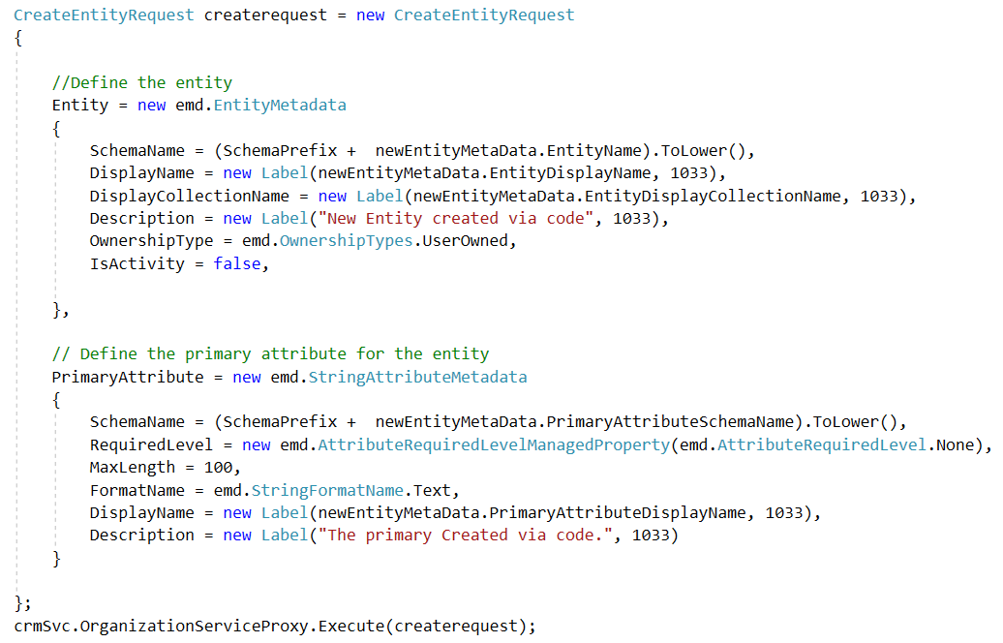
Notes:
The CreateRequest object would be passed to the Execute method of the OrganizationServiceProxy.

Slide 10
Creating Attributes for an Entity
The CreateAttributeRequest takes an AttributeMetadata object
BooleanAttributeMetadata
DateTimeAttributeMetadata
IntegerAttributeMetadata
LookupAttributeMetadata
MoneyAttributeMetadata
PicklistAttributeMetadata
StringAttributeMetadata
Notes:
Each of the major field types is created by first creating a specific AttributeMetadata object, each with data type specific properties. A numeric attribute has minimum and maximum properties, a Money attribute has an accuracy property, a string attribute a maximum length,

Slide 11
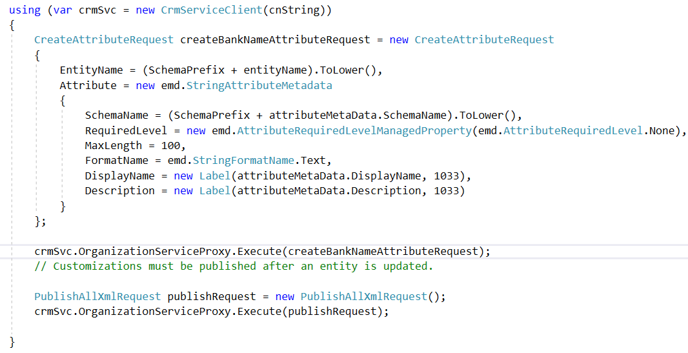

Slide 12
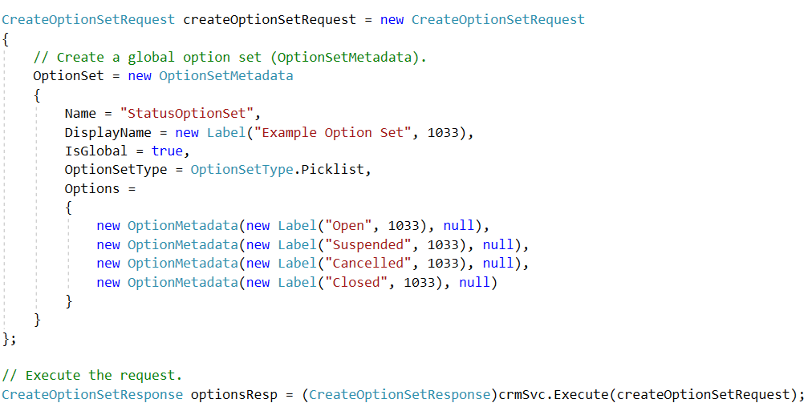
Creating Global OptionSets
Notes:
public static OptionMetadata[] ReturnGlobalOptionSet(IOrganizationService _serviceProxy, string _globalOptionSetName)
{
RetrieveOptionSetRequest retrieveOptionSetRequest =
new RetrieveOptionSetRequest{ Name = _globalOptionSetName };
// Execute the request.
RetrieveOptionSetResponse retrieveOptionSetResponse =
(RetrieveOptionSetResponse)_serviceProxy.Execute(
retrieveOptionSetRequest);
Console.WriteLine("Retrieved {0}.", retrieveOptionSetRequest.Name);
// Access the retrieved OptionSetMetadata.
OptionSetMetadata retrievedOptionSetMetadata =
(OptionSetMetadata)retrieveOptionSetResponse.OptionSetMetadata;
// Get the current options list for the retrieved attribute.
OptionMetadata[] optionList =
retrievedOptionSetMetadata.Options.ToArray();
return optionList;
}

Slide 13
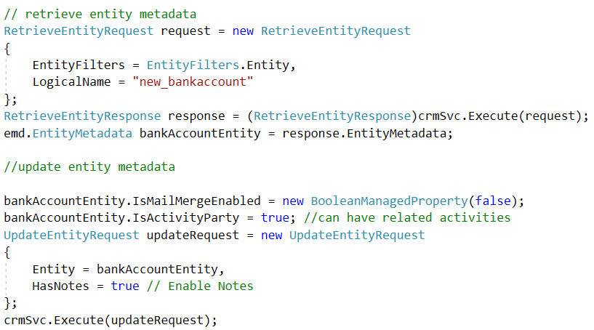
Execute method - RetrieveMetaData Request
Notes:
The RetrieveEntityRequest can be used to extract the metadata for an entity, then read or modify various attributes.
RetrieveEntityRequest request = new RetrieveEntityRequest
{
EntityFilters = EntityFilters.Entity,
LogicalName = "new_bankaccount"
};
RetrieveEntityResponse response = (RetrieveEntityResponse)service.Execute(request);
//CreateUpdateEntityMetadata.RetrieveEntity
EntityMetadata entity = response.EntityMetadata;
BankAccountEntity.IsMailMergeEnabled = new BooleanManagedProperty(false);
BankAccountEntity.IsActivityParty = true;
UpdateEntityRequest updateRequest = new UpdateEntityRequest
{
Entity = BankAccountEntity,
HasNotes = true // Enable Notes
};
service.Execute(updateRequest);

Slide 14
Module 3 Lab A
Creating Custom Entities

Slide 15
Summary
Execute method of the Organization Service, allows access to CRUD and CRM system operations
Metadata requests allow querying properties of the entities and attributesI
Using Metadata Requests to Create Entities and Attributes allows for dynamic creation of components in CRM systems, as opposed to a static solution

